Slide 1
Linkages between pricing and demand management
ENA Smart Networks Summit 17 – 18 May 2011 Sydney

Slide 2
Key issues
The important of price and price structure
What SMI (AMI) will enable in terms of pricing
Choices for retailers
Choices for distributors
Choices for customers
Implications for vulnerable customers
Implications for demand management

Slide 3
The importance of price and price structure
Prices remained relatively low in real terms until 2008
Total energy consumption grew steadily, though peak demand grew faster largely due to strong economy and rapid increase in penetration of air-conditioning
Load factors decline, which drives up average unit price
Significant prices increase begin, particularly in NSW and QLD
Some DBs (Ausgrid, Energex) start to notice a decline in weather normalised consumption in the residential sector, though peak demand continues to grow (though slower than previously)
But the combination is likely to be even worse for load factor: Ausgrid forecast to 2019 (total system load):
Peak demand: +1.6% pa
Energy consumption: - 1.4% pa
This is a rationale response to price by consumers to largely flat energy pricing.
Consumers respond to price and price structure.
Current pricing exacerbates the ‘top end’ problem.

Slide 4
What SMI (AMI) will enable in terms of pricing
The profile available from an interval meter will allow accurate assessment of the customer’s use of wholesale energy and network assets, and therefore the real cost of being served
IHD, web portals and other applications will provide customers with very granular information on their energy use
In most cases, though, price (rather than information alone) will drive behaviour
Customers, retailers and distributors will face new choices

Slide 5
Choices for retailers
The serving retailer will know
Which customers they are serving at a loss
Which customers are producing above average profit
The first thing to note is that this unwinds hidden cross subsidies between individual customers
It also dis-creates the prima facia retail value of larger volume customers
When all customers have the same profile, the largest provide the largest retail margin
More importantly
The price offer to the former group will go up, as the retailer will not want to knowingly serve customers at a loss
The retailer will also need to be prepared to offer a better price to the latter group as they will be vulnerable to other retailers willing to serve them at an average profit and who can determine how to do so by assessing the load profile

Slide 6
Choices for distributors
AMI (and the now virtually complete separation of distribution and retail businesses) opens a number of questions that have always been there:
What commodity should we price – kWh, kW, kVa?
On what basis should we differentiate our pricing – end-use customer class or use of system assets?
Who are our customers – end users or retailers?
Our strawman for best outcomes:
Price cost-reflectively (price based on cost-drivers; price for indifference)
Price based on use of system assets
Price to retailers
Benefits
Reduces revenue risk
Provides correct signals to the parties that can best manage them
Provides a rational basis for further involvement of distributor in demand management
Makes network indifferent to (or at least provide insulation against) policy decision regarding carbon outcomes

Slide 7
A wide range of new pricing structures is available
Critical peak price (CPP)
A higher price is set for a predetermined number of hours or days on which demand and/or energy price is likely to be at its very highest levels
The price is fixed, but the duration of the event may be fixed and non-varying from event to event (CPP-F) or it can vary (CPP-V)
Consumers are notified in advance of each critical peak event; generally the day before the event, but can be less depending on the particular pricing arrangement
In CPP-V consumers are notified about the duration of the upcoming event at the same time
Is often superimposed over a ToU structure, but can also be combined with a flat tariff
Variable peak price (VPP)
Essentially a CPP in which the price can also vary and is notified to consumers prior to the event
Note that CPP tariffs are essentially a means for pricing demand in energy terms
AMI will allow distributors to price based on demand, including combinations of peak demand, anytime maximum demand and average demand
Many historical reasons why this hasn’t been done and will require a significant transition

Slide 8
Possible pricing structures (cont’d)
Peak time rebate (PTR)
Set up like CPP in that a set price is established that will pertain during specific hours on a maximum number of days upon notification by the utility
However, rather than this price being a price the customer pays during those periods it is a rebate that is paid by the utility for each kWh that the customer reduces consumption on event days below his/her baseline consumption on similar days
One issue is where this money comes from
RTP
Consumer is charged a price that reflects actual movements in wholesale electricity price
These types can be used in combination, for example:
CPP or PTR can be superimposed over a flat tariff or a time of use
RTP can be used for the variable part of a load, with the baseload on a static ToU or flat tariff

Slide 9
Dynamic pricing arrangements shift risk
More
risk averse
customers
Less
risk averse
customers
Reward
(discount
from flat
tariff)
More risk stays with distributor or retailer
More risk is shifted to retailer orcustomer
10%
RTP
PTR
VPP
CPP
5%
TOU
Seasonal Rate
IBT
Flat Rate
Source: The Brattle Group
Risk
(variance in
price)
0.5
1.0

Slide 10
Implications of changes in network price structure
Evidence everywhere suggests that while customers may find they can cope with time-varying prices, and even benefit from them, most do not accept them voluntarily
As a result, retailers have tended to offer flatter pricing structures – and they will continue to try to respond to what customers want
Traditional network pricing has been relatively easy for retailers to cope with – most network tariffs for smaller volume customers tends to be energy based, and the retailer can simply add the charge to all portions of the NSLP for pricing (no price risk, no incremental volume risk)
There is no counterparty for a financial hedge on network charges
Where the network tariff introduces either (or both) more volume or price risk, the retailer will be less likely to repackage the network price
A three part static TOU network tariff is more likely to be able to be ‘absorbed’ by the retailer within its price offer as compared to, say, a critical peak day demand network tariff

Slide 11
Result
The distribution charge is more likely to get through to the end-use customer
If it doesn’t, the retailer has to deal with the risk
In either case the pricing can make distributor economically indifferent:
If peak demand is reduced, the reduction in revenue equals the long run average incremental cost of demand that will not be needed
If peak demand grows, the long run average incremental cost needed to fund augmentation is collected

Slide 12
Customers are likely to have more choices
As in any business, more information about how customers use a product leads to more segmentation of products and offers
Flat price offers will still be available
Will be based on the customer’s profile (or a time-band simplification of it) with a risk premium
Will be more cost reflective than the current flat tariff
Sculpted offers will also be available for those customers that want them
‘Passive winners’ – those with lower cost to serve profiles (i.e., those who have been subsidising others under the NSLP)
Those who can change their consumption to produce a lower cost to serve profile
There will be a need for the retailers to develop tools that can quickly process profile information – or surrogate information – into offers
There is likely to be a continuing role for Government or third parties to provide bill comparison services (though the input data will become more complex and costly to process)
There will be a role for the provision of tailored advice to customers on ways they can change they behaviour or end-use technologies to produce a lower cost to serve profile while maintaining acceptable lifestyle amenity

Slide 13
What about those who can’t change their profile?
They will face the actual cost of their electricity service
There will be a need for social welfare programs for some customers, but presenting the right price is vital
Social welfare should include technology enablement that AMI (if installed) will allow
Will customers with poor load profiles have difficulty getting offers?
May be difficult for them to get offers they will like, but there is no reason to believe that offers won’t be available
Poor credit history will undoubtedly be a factor (but is likely to be a factor even for customers with relatively ‘good’ profiles)

Slide 14
Next steps for distributors to consider
If you look like you are broken, someone will come along to fix you
While this is true of the industry as a whole (viz. the number of reviews going on, particularly about why prices have gotten so high), it is arguably most true in relation to the networks
The alternative is for the industry to take the lead in identifying what needs to be done
With regard to DM, it is noteworthy that of the 5 questions raised by the AEMC in its recent Strategic Priorities for Energy Market Development Discussion Paper, 4 were directed to networks
“Who owns the ‘property right’ to control loads – is it always the customer, or might it be the retailer or system operator (or the network business) in some circumstances?”
“What should regulated networks be obliged to do in respect of investment in, and providing access to, smart grid technology – and how should economic regulation be designed to provide the right incentives?”
“What is the boundary between regulated and competitive activities in this space, and how should access and pricing be regulated across this boundary to promote competition and enable innovation and flexibility whilst providing appropriate customer protection?”
"Technology could create scope for network businesses (or affiliate businesses) to sell products in the wholesale market, e.g. load reduction sold as a hedge contract in direct competition with generators.”

Slide 15
AEMC’s strategic focus on DM
Note that the AEMC is primarily concerned with demand response to address low duty-cycle infrastructure
Cost-effective demand-side participation in the electricity market can help reduce the need for more generation and network investment to meet forecast increases in peak demand. (page 39, emphasis added)
This strategic priority has the potential to mitigate the impact of rising prices, and to increase market resilience, particularly if more demand side participation is available at times of high demand. (page 39)
The AEMC wants to ensure that there are no unnecessary barriers to cost effective demand side participation and development of energy efficiency measures. (page 44)
AEMO (2010-11) estimates that there may be as much as 600 MW of demand response in the NEM (about 3.5% of installed capacity)
177 MW very likely to educe consumption in response to high prices
423 MW with an even chance of doing so
By contrast, WA has about 450 MW – about 12% of its installed capacity (and increasing)

Slide 16
But why the sudden interest in networks for demand response?
Clearly, there isn’t much demand response in the market
Vertical integration
Caps and other financial hedge instruments are generally readily available and relatively inexpensive
Demand response, by contrast, has high transaction costs for prospecting, administering and settling
And there is a good commercial reason for there not to be too much DR
Where a retailer is exposed to pool price (unhedged volume) and has a fixed price to the end-use customer, it will want to reduce that volume
If the retailer is vertically integrated it may not want – even in this situation – to change pool price
In all other situations (ie, when the retailer is hedged) the benefit of DR is essentially an arbitrage of the pool price and the strike price – there is no incentive to change pool price as it reduces income to both the retailer and the customer(s) providing demand response
This application of DR amounts to a wealth transfer from generators to retailers and DR providers (where the retailer is also a generator the incentive is limited to customer acquisition and retention/satisfaction)
It is reasonable to expect that beneficial changes to the network load duration curve will also be beneficial to the wholesale market

Slide 17
What stops networks from doing DR?
Current incentives overwhelmingly favour investment in network augmentation
Supply side advantages:
Culture/practice/track record: networks are expert in and comfortable with supply-side solutions
There is a mature market of suppliers, products and constructors of supply-side solutions
Established track record of being able to deliver supply-side solutions on time and on budget
Very comfortable with the delivered reliability of the technology, which is primarily passive – once installed it provides the rated capacity in the overwhelming majority of cases and situation
(and not the least) it is how networks earn money
Corresponding demand-side disadvantages:
Generally low capex so earning potential is low (and may be existing prohibitions from network owning assets on customer side of the meter, which further reduces RAB potential)
Is not an off-the-shelf purchase as supply-side is – at present DR must be prospected and transacted; networks have little expertise in these areas, and it adds to the time required and the costs
No (or little) track level of deliverability of these projects for networks
(and therefore) Easy to suspect that demand-side may not respond when needed so reliability appears less good than supply-side, or unacceptable

Slide 18
What can networks do?
As discussed, new approaches to network pricing can:
give an explicit price signal regarding low duty-cycle infrastructure, and
make networks much less financially dependent on throughput
Overcoming these disadvantages will require a transition phase and a permanent change in incentives for networks
Incentives will need to reward network for doing a demand-side alternative – they will need to be financially at least as well off as if they did the supply-side option.
Performance incentive modelled on the mechanics of the STPIS
DMIS
A transition period will be needed that will need to cover higher transaction costs of demand–side solutions (at least through a significant activation phase) and provide the capability for the network to revert to the supply-side alternative if demand side does not prove up in a particular instance
In the longer term, transaction costs should reduce as standardised processes are developed and some level of known (standing) capacity in DR is developed
Pricing can be done now – but it is a journey

Slide 19
Managing the transition in network pricing
Stakeholder, shareholder and community concerns will all need to be managed:
The magnitude and speed of price increases
The ability for an effective welfare support mechanism to be put in place
The need to continue to recover required revenue over the transition period
Community expectations regarding network/industry involvement in DM and energy efficiency
The historical resistance of customers and reticence of regulators regarding increasing fixed charges or demand based charges with regard to small volume users, and the need to be able to explain the rationale for them, while also providing mitigation strategies
The level of cross subsidy that exists in the current tariffs when transposed to a use of system asset framework and what that implies, in light of the other factors above for unwinding them
The reactions of retailers to the network prices as they unfold
An iterative process

Slide 20
But it can work
A very similar approach has been used successfully for about 18 years in NZ by Orion Energy – based on Long Run Average Incremental Cost (LRAIC) process we developed in 1993 – now applies even to low voltage customers
Tariff Component
Peak Charge | 42.80 cents/kW/day | Charged based on usage recorded on dynamic peak days
Energy Charge Working Week Days | 6.215 cents/kWh | 7 am to 9 pm
Energy Charge - Other | 0.785 cents/kWh | Rest is all Off peak
Retailers charged in aggregate for their customer load on the Orion Network
They also deploy peak reduction rebates and embedded generation credits using the LRAIC – settled at Grid Exit Points (using NEM type data)
All major Retailers voluntarily installed Interval meters in response

Slide 21
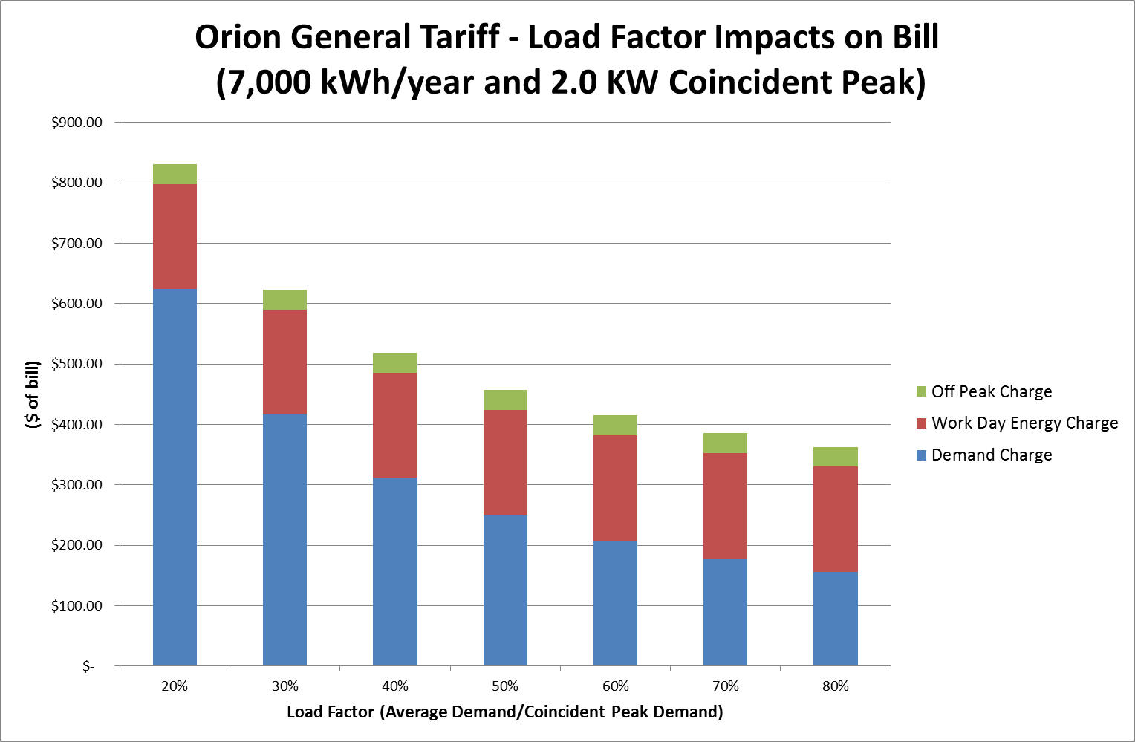
Impact of load factor on low voltage tariff charged to Retailers

Slide 22
Living in the modern world is a lot like having bees in your bonnet –
but there they are.
Duck’s Breath Mystery Theatre
Thank you
Lance Hoch Oakley Greenwood Pty Ltd GPO Box 4345 Melbourne 3000 +61 4 1172 1386
lhoch@oakleygreenwood.com.au

